Slide 1
Autism Detection in Children Using Facial Image
Project Guide:
Dr. Sabitha S
SANGEETH A P
TVE19MCA048
S6 MCA

Slide 2
INTRODUCTION
Autism is the imperfect development of children's brains that interfere with their social interaction.
Many of the problems with this disease are that children do not understand, learn precisely, and have difficulties interacting and communicating.
The system will detect whether children is autistic or not using facial image.
Notes:
How presentation will benefit audience: Adult learners are more interested in a subject if they know how or why it is important to them.
Presenter’s level of expertise in the subject: Briefly state your credentials in this area, or explain why participants should listen to you.

Slide 3
PROBLEM DEFINITION AND MOTIVATION
It is a very challenging task for the doctors or physicians to identify autistic children just by seeing their behavioral activities for a certain period of time.
A child can be diagnosed with ASD as early as 18 months old.
1 in every 54 children has autism problems.
Notes:
Lesson descriptions should be brief.

Slide 4
LITERATURE REVIEW
Year | Author | Title | Method
2021 | M. F. Rabbi, S. M. M. Hasan, A. I. Champa and M. A. Zaman | A Convolutional Neural Network Model for Early-Stage Detection of Autism Spectrum Disorder | Random Forest (RF), AdaBoost (AB) and Convolutional Neural Network (CNN)
2018 | Madison Beary, Alex Hadsell, Ryan Messersmith, Mohammad-Parsa Hosseini | Diagnosis of Autism in Children using Facial Analysis and Deep Learning | MobileNet
Notes:
Example objectives
At the end of this lesson, you will be able to:
Save files to the team Web server.
Move files to different locations on the team Web server.
Share files on the team Web server.

Slide 5
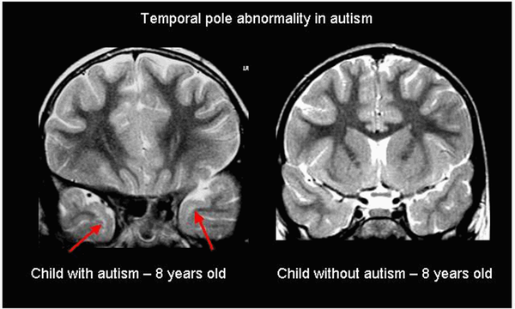
EXISTING SYSTEM
To classify children with autism or not was based on the analysis of brain images.
Focused on analyzing images of cerebral white matter (CWM) in individuals.

Slide 6
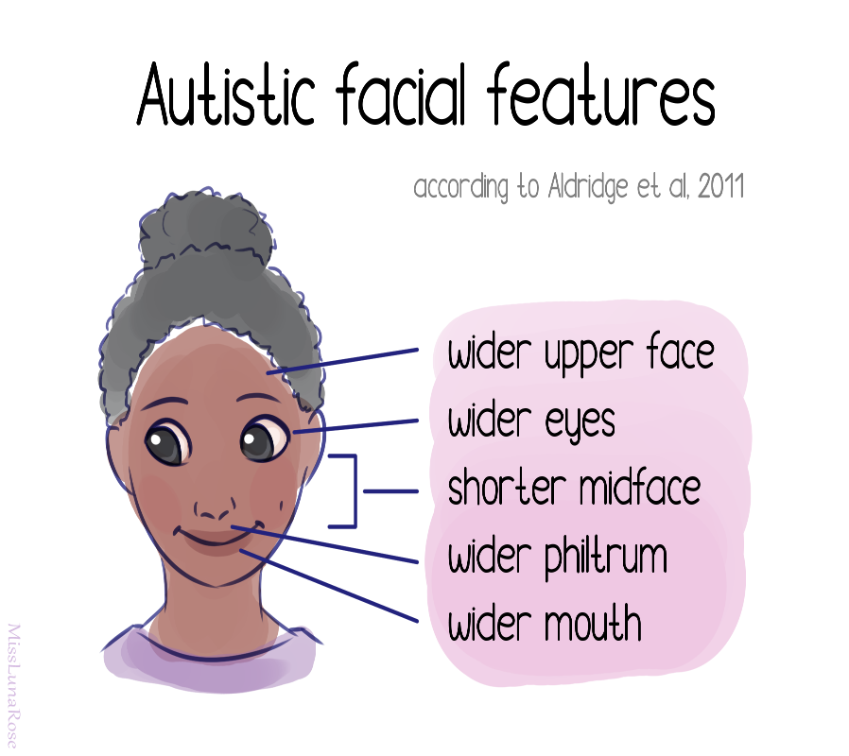
PROPOSED SYSTEM
Children diagnosed with autism share common facial feature distinctions from children who are not diagnosed with the disease.

Slide 7
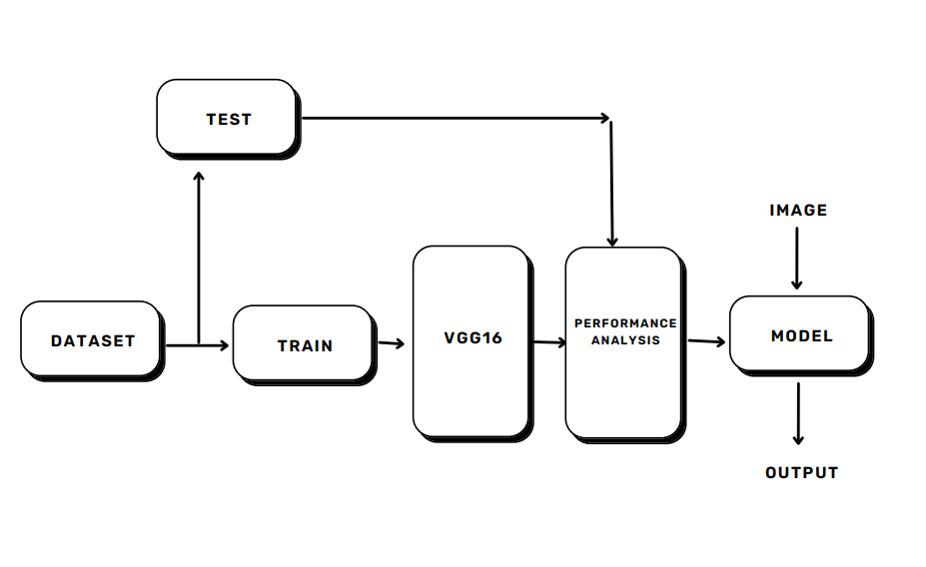
SYSTEM DESIGN

Slide 8
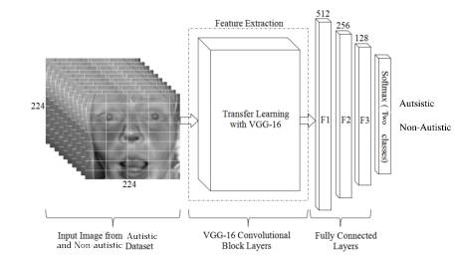
VGG16 ARCHITECTURE

Slide 9
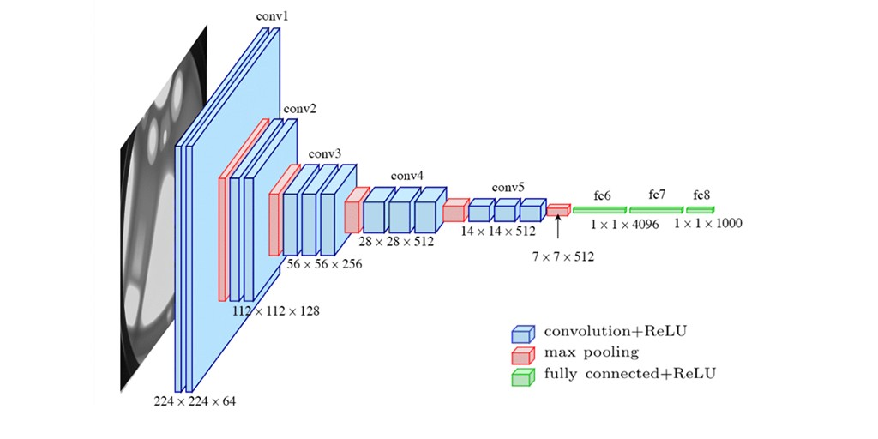

Slide 10
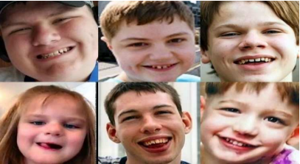
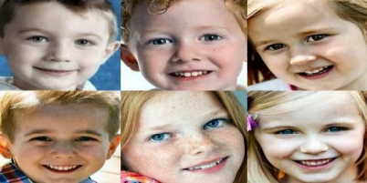
DATASET
Autistic_Dataset
Non_Autistic_dataset

Slide 11
IMPLEMENTATION
Preprocessing the dataset.
Preprocessed dataset is used to re-train the VGG16 model.
Predicts whether child is autistic or not.
Created a user interface using HTML, CSS, JavaScript and integrated them using Flask.

Slide 12
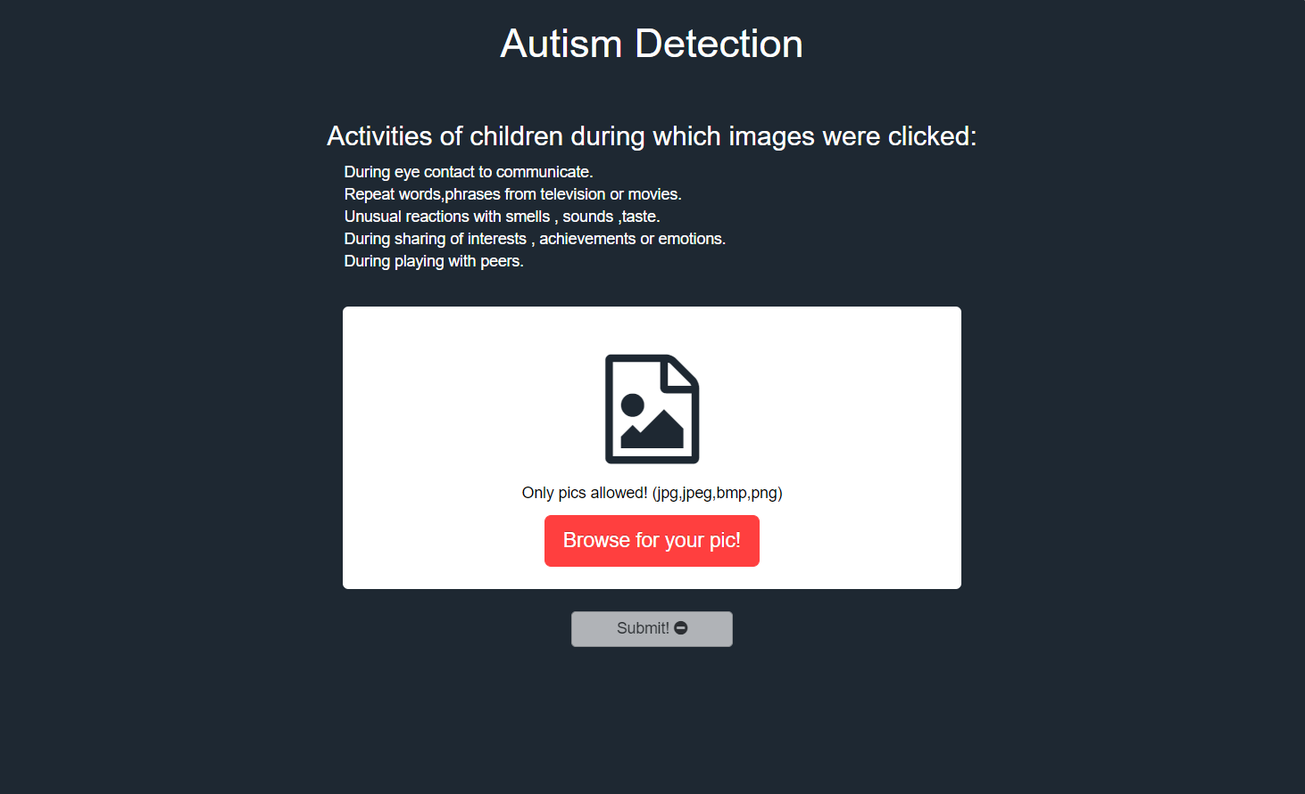
USER INTERFACE

Slide 13
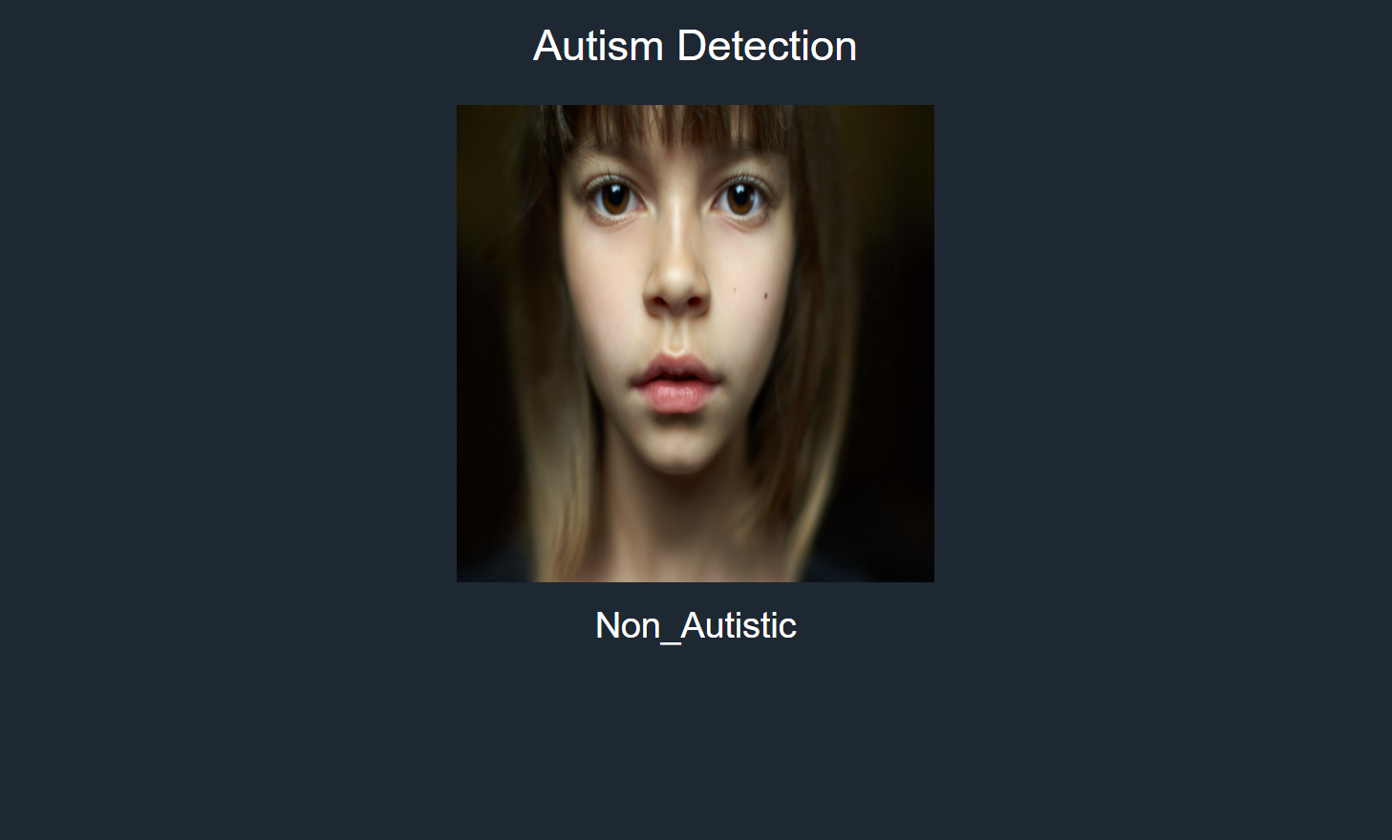
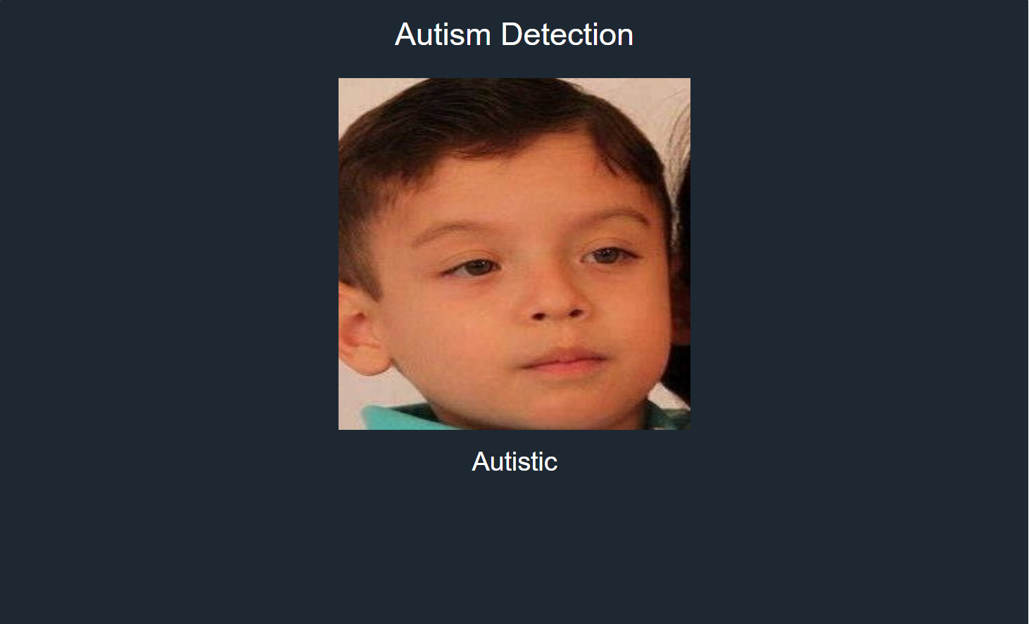
USER INTERFACE

Slide 14
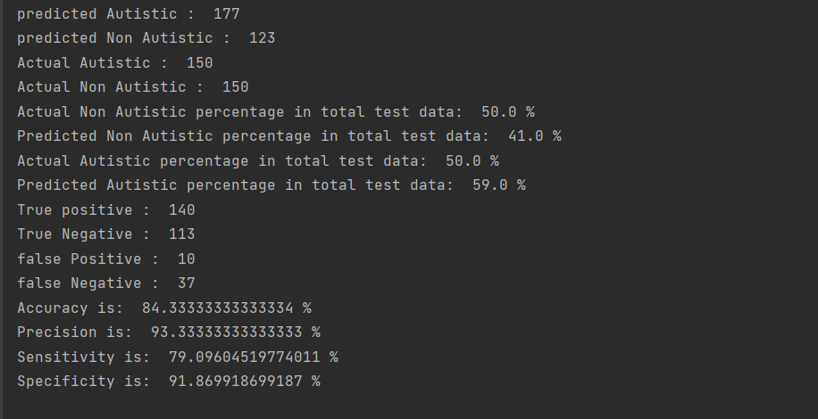
ACCURACY MEASURES

Slide 15
FUTURE SCOPE
We extend the model with an artificial intelligence algorithm that analyses children’s actions on video and determines whether they are symptoms of autism spectrum disease

Slide 16
CONCLUSION
Our results show we successfully achieved a high accuracy of 84.3%, meaning that it was able to identify a child with or without autism correctly.
It gives better accuracy compared to other CNN models.

Slide 17
REFERENCE
M. F. Rabbi, S. M. M. Hasan, A. I. Champa and M. A. Zaman, "A Convolutional Neural Network Model for Early-Stage Detection of Autism Spectrum Disorder," 2021 International Conference on Information and Communication Technology for Sustainable Development (ICICT4SD), 2021, pp. 110-114, doi:10.1109/ICICT4SD50815.2021.9397020
Madison Beary, Alex Hadsell, Ryan Messersmith, Mohammad-Parsa Hosseini, “Diagnosis of Autism in Children using Facial Analysis and Deep Learning” Department of Bioengineering, Santa Clara University—Santa Clara, CA, USA
C. Wu, S. Liaqat, S. -c. Cheung, C. -N. Chuah and S. Ozonoff, "Predicting Autism Diagnosis using Image with Fixations and Synthetic Saccade Patterns," 2019 IEEE International Conference on Multimedia & Expo Workshops (ICMEW), 2019, pp. 647-650, doi: 10.1109/ICMEW.2019.00125.

